Slide 1
Economic Analysis in Relation to Australia’s Population
James Le Kathleen Lopokoiyit
Radhika Alapati Dante Company

Slide 2

introduction
The Outlook for the Australian Economy is changing and being driven by Covid-19 pandemic.
The economic growth is forecast to be slower and inflation higher.
We have looked at how the changes in Population has impacted the Economic Growth over a 10 Year Period.
For the World, over the period of 1990-2015, the correlation between population growth and real GDP per capita, based on the World Bank Report 2017.

Slide 3

Objectives of the Study
To explore key aspects of the changes in Australian GDP in the past 10 years.
To compare changes in the Australian growth to that of the World Population.
Does the population growth impact the Economic growth of Australia.
To find out if the Birth and Death Rate have had an impact on the natural increase in population
To describe how migration has impacted changes affected the population growth in Australia.
To show projected changes in the Australian Population growth with changes in the migrated populations.
To compare the World GDP per capita to Australia’s GDP

Slide 4
Hypothesis
H0: Changes in the Australian Economy have not affected the Population.
H1: Changes in the Australian Economy have had an impact on the Population.
H0: There is no Correlation between GDP per Capita and the Population Growth.
H1: There is a Positive Correlation between GDP per Capita and the Population Growth
H0: Immigration has not had a Significant Impact on Australia’s and the World’s Economy
H1: Immigration has had a Significant Impact on Australia’s and the World’s Economy

Slide 5
Questions
Has changes in the Australian Economy affected the Population of Australia?
Is there a Correlation between the GDP per Capita and the Population Growth?
Has Immigration played a Significant Impact on Australia’s and the World’s Economy?
dante

Slide 6
WBGAPI
Pythonic access to the World Bank’s Data API.
Australian Economic data are pooled for the period of 2010-2020 from the World Bank API. Key economic indicators are compared against the population changes within the same time period.
dante

Slide 7
Questions and Data
dante

Slide 8
Data cleanup & Exploration
radhika

Slide 9
Data analysis
Radhika

Slide 10
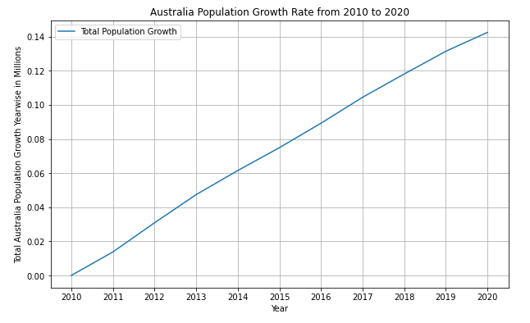
Australian Population Growth Rate 2010-2020

Slide 11
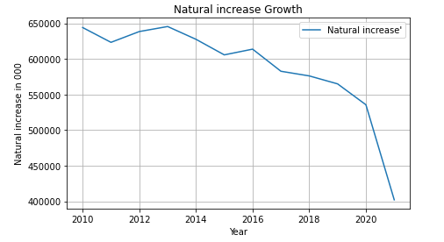
Natural Increase Growth

Slide 12
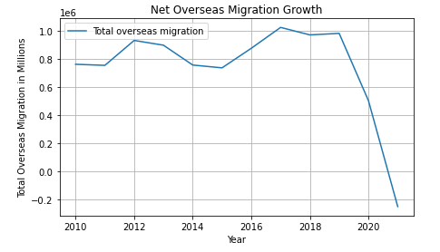
Net Overseas Migration Growth 2010-2020

Slide 13
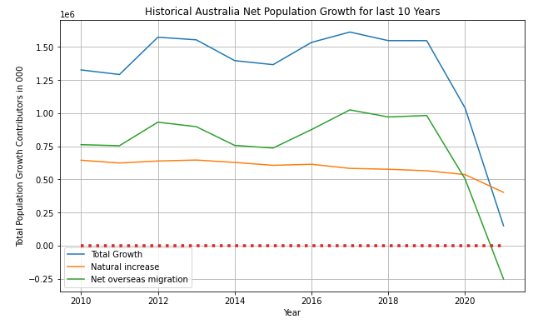
Historical Australia Net Population Growth 2010-2020

Slide 14
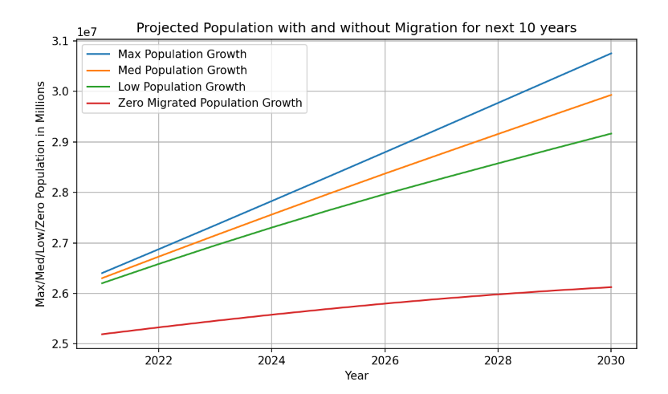
Projected Population with and without Migration for 2020-2030

Slide 15
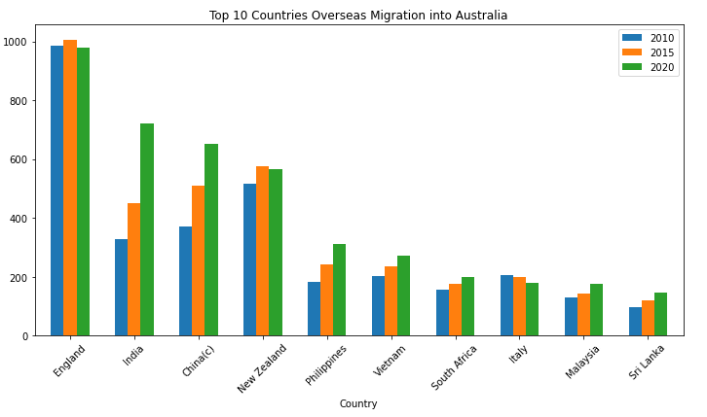
Top 10 Countries Overseas Migration into Australia. 2010, 2015, 2020

Slide 16
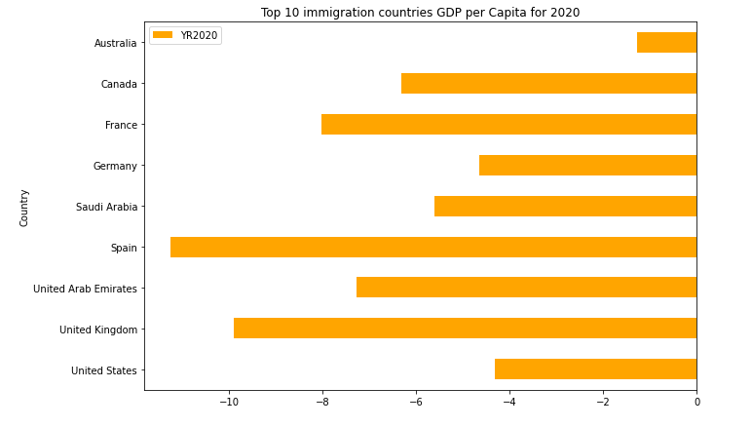
Top 10 Immigration Countries GDP per Capita 2020

Slide 17
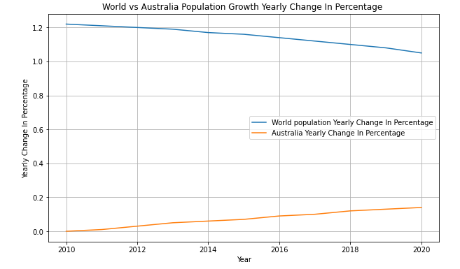
World Population Growth vs Australia Population from Last 10 Years

Slide 18
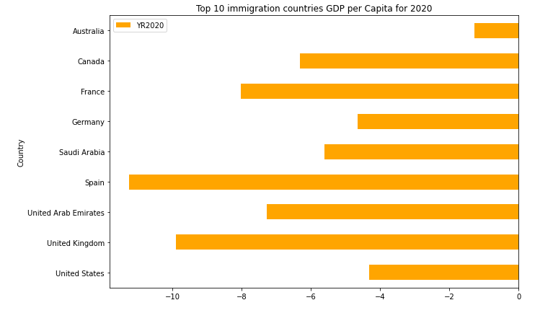
Top 10 Immigration Countries GDP per Capita 2020

Slide 19
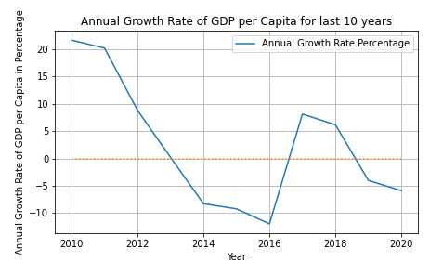
Australia GDP per Capita Growth Rate Percentage

Slide 20
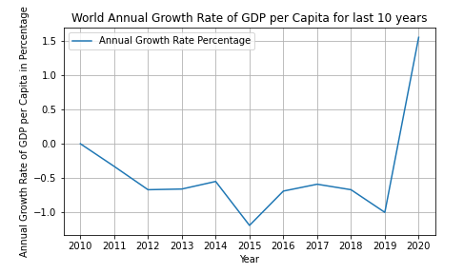
World GDP per Capita Growth Rate Percentage

Slide 21
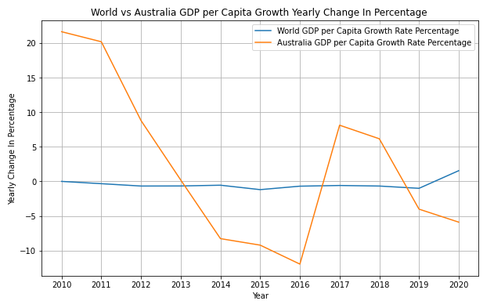
World vs Australia GDP per Capita Growth Rate Percentage

Slide 22
Conclusion
kathleen

Slide 23
Post mortem
Discuss your findings. Did you find what you expected to find? If not, why not? What inferences or general conclusions can you draw from your analysis? Discuss any difficulties that arose, and how you dealt with them Discuss any additional questions that came up, but which you didn't have time to answer: What would you research next, if you had two more weeks?
kathleen

Slide 24

QUEstions

Slide 25
Thank you

